Slide 1
Digital Portfolio
STUDENT NAME: HUMYRA SAIMAH K
REGISTER NO AND NMID: 31224U09037
DEPARTMENT: BCA
COLLEGE: COLLEGE/ UNIVERSITY
Islamiah women art and science college

Slide 2
“
PROJECT TITLE “Creative Portfolio for Career Growth”

Slide 3


AGENDA
Problem Statement
Project Overview
End Users
Tools and Technologies
Portfolio design and Layout
Features and Functionality
Results and Screenshots
Conclusion
Github Link
3/21/2024 Annual Review

Slide 4

PROBLEM STATEMENT
In today’s digital world, a traditional resume is not enough to highlight both technical skills and creative talents. A personal portfolio website provides an interactive and professional way to showcase projects, achievements, and creativity in one place.

Slide 5

PROJECT OVERVIEW
A personal portfolio website to showcase my skills, projects, and achievements.
It provides a professional platform to highlight my creativity and technical abilities.
The portfolio also helps in building a strong career profile.

Slide 6

WHO ARE THE END USERS?
🔹Recruiters & Employers – to view my skills and projects. 🔹Teachers & Mentors – to evaluate academic performance. 🔹Clients & Collaborators – to check my work for future projects. 🔹General Audience – anyone interested in my profile.

Slide 7

TOOLS AND TECHNIQUES
🔹HTML, CSS, JavaScript – for building the portfolio. 🔹Visual Studio Code / CodePen – for coding and testing. 🔹Canva / Photoshop – for graphics and design

Slide 8
PORTFOLIO DESIGN AND LAYOUT
🔸Clean & Professional look with modern design. 🔸Responsive Layout – works on mobile, tablet, and desktop. 🔸Organized Sections – About Me, Skills, Projects, Contact. 🔸Simple Navigation for better user experience.
8

Slide 9
FEATURES AND FUNCTIONALITY
📍User-Friendly Navigation – easy menu and smooth scrolling
📍Responsive Design – works on mobile, tablet, and desktop
📍Project Showcase – displays your video editing & graphic design work 📍Interactive Elements – hover effects, animations, transitions 📍Contact Form – allows recruiters to connect easily

Slide 10
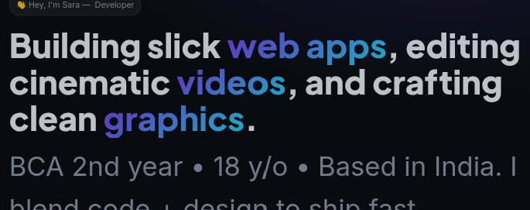

RESULTS AND SCREENSHOTS
3/21/2024 Annual Review
10

Slide 11
CONCLUSION
◾Highlights – Showcases my skills in web development, video editing, and graphic design. ◾Summary – A responsive and interactive portfolio built with HTML, CSS, and JavaScript. ◾Benefits to Society – Inspires students and young developers to build their own portfolios, promotes creativity, and improves digital presence for career opportunities.
11

